Slide 1
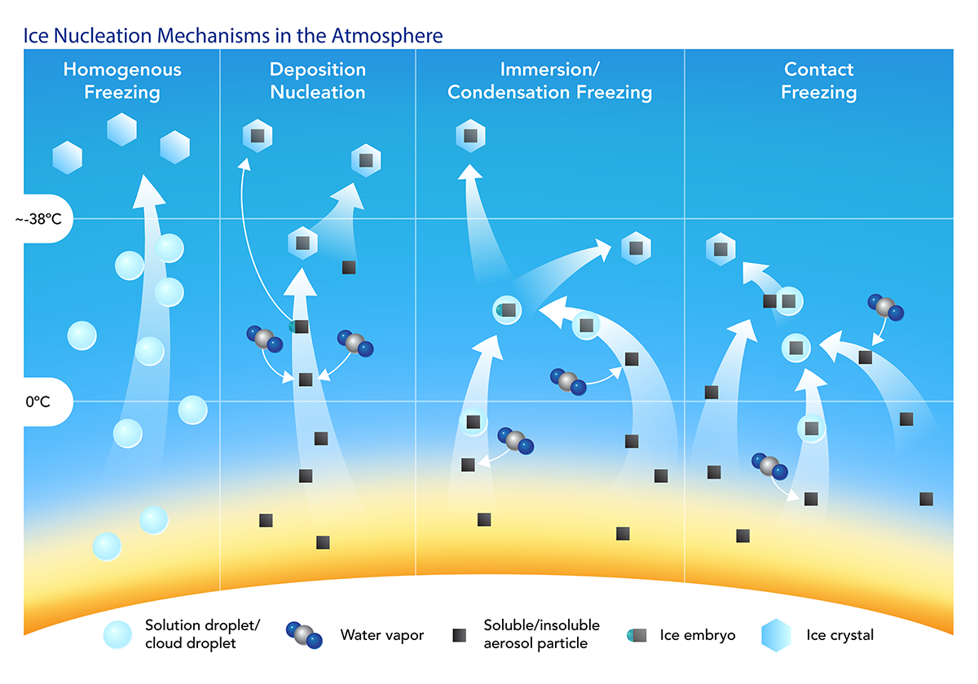
Different modes of Primary ice particle formation in the atmosphere

Slide 2
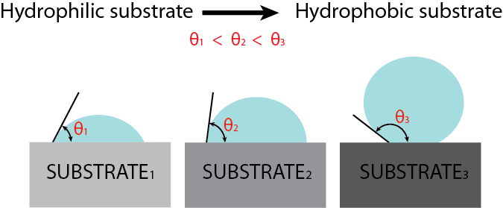
Lab studies: Cloud model Sensitivity studies
Assume contact angles (θ) as the proxy for ice nucleation efficiency of aerosol surface (or substrate).
Aerosol surface properties influences cloud initiation and thickness. Accurate representation of Ice Nucleation properties is critical for predicting Ice clouds in a model. Currently, Ice Nucleation is very poorly understood microphysical process.

